Slide 1


Slide 2
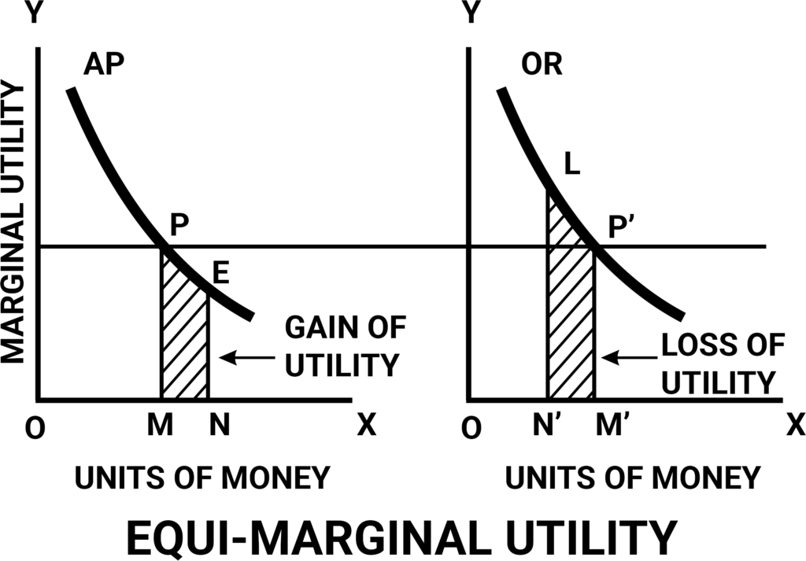

Slide 3
Meaning
It is the second important law of the utility analysis. This law was first propounded by Gossen. It is known as “Gossen’s Second Law”
This law points out how a consumer can get maximum satisfaction out of given expenditure on different goods.
The law states that in order to get maximum satisfaction, a consumer should spend his limited income on different commodities in such a way that the last rupee spent on each commodity yields him equal marginal utility.
Notes:
The fundamental problem in an economy is that there are unlimited human wants. However, there are no adequate resources to satisfy all human wants. Hence, a rational individual tries to optimize the available scarce resources in order to attain maximum satisfaction. An individual’s attempt to optimize the available scare resources is known as consumer’s behavior. The law of equi-marginal utility explains such consumer’s behavior when the consumer has limited resources and unlimited wants. Because of this reason, the law of equi-marginal utility is further referred to as the law of maximum satisfaction, the principle of income allocation, the law of economy in expenditure or the law of substitution.

Slide 4
Definition
Dr. Marshall, “If a persons has a thing which he can put to several uses, he will distribute it among these uses in such a way, that he has the same marginal utility in all.”
This law can be explained as
Traditional statement
Modern statement

Slide 5
1. Traditional Statement of the law
According to traditional statement consumer will spend his money income in such a way that last rupee spend on each product will give him equal Satisfaction.
MU1 = MU2 = …………….Mun

Slide 6
Conditions
There must be two or more commodities
What ever marginally utility he gets from both commody must be equal
He must spent all the income

Slide 7
Explanation
Income= Rs 100
Price of Apples =20, Banana = Rs. 10
Unit | MU of Apples | MU of Banana
1 | 10 | 12
2 | 8 | 10
3 | 6 | 8
4 | 4 | 6
5 | 2 | 3
1*20=20
2*10=30
50rs spent
3*20=60
4*10=40
100rs spent

Slide 8
2. Modern Statement
Modern economist also call it as the ‘ Law of Proportionality’.
According to them a person gets maximum satisfaction when the weighted marginal utilities are equal. In other words, when marginal utilities of one commodity divided by its price and the marginal utility of the other commodity divided by its price are equal.
MUa MUb MUc
Pa Pb Pc
-------- = ------------ = -----------

Slide 9
Total money=Rs24
Price of X= Rs 2
Price of Y= Rs 3
 | MU of x & y |  | MU of money Expenditure
Units | MUx | MUy | MUx/Px | MUy/Py
1 | 20 | 24 | 10 | 8
2 | 18 | 21 | 9 | 7
3 | 16 | 18 | 8 | 6
4 | 14 | 15 | 7 | 5
5 | 12 | 9 | 6 | 3
6 | 10 | 3 | 5 | 1
In Modern method,calculating marginal utility with respect to price
Notes:
In Modern method,calculating marginal utility with respect to price

Slide 10
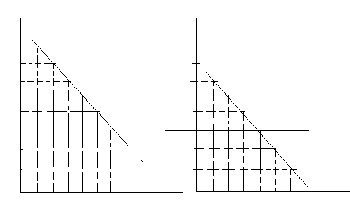
Consumer’s choice under Law of Equi -marginal utility
Y
10
9
8
7
6
5
4
3
O
Y
MUx/Px
MUy/Py
1 2 3 4 5 6 X O 1 2 3 4 5 6 X
Quantity of X Quantity of Y

Slide 11
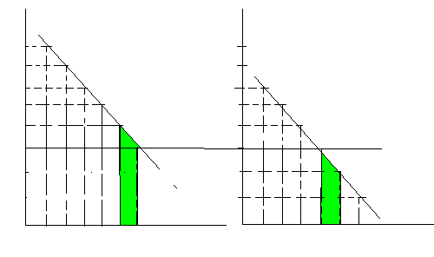
Y
10
9
8
7
6
5
4
3
O
Loss
Gain
1 2 3 4 5 6 X O 1 2 3 4 5 6 X
Quatity of X Quantity of Y

Slide 12
Importance of the law
Consumption
Production
Exchange
Price discrimination
Distribution
Public finance
International trade
Distribution of assets
Distribution of time
Saving and investment

Slide 13
Criticism
Non availability of goods
Influence of fashion, customs and habits
Tastes and preferences are not constant
Indivisibility of goods
Change in income and price
Complementary goods
Marginal utility of money does not remain constant

Slide 14
Thank u

